Slide 1
HMDA Data Challenge
Shobhit Dalal

Slide 2
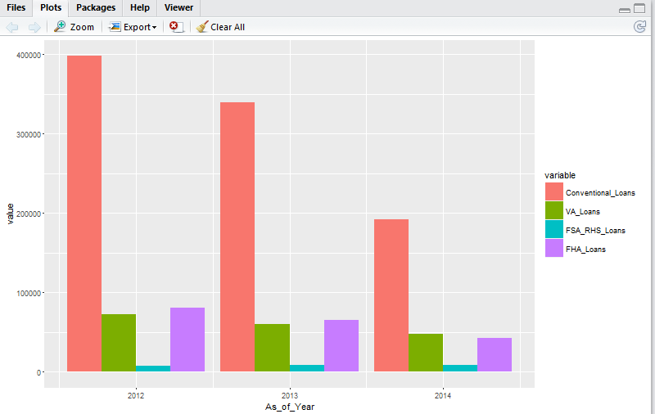
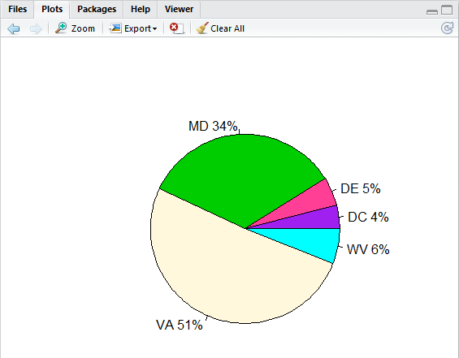
Market Size by Year & State
On analyzing market size by year and state we see that the share of conventional loan is very high compared to VA, FSA and RHS loans
Virginia & Maryland have the highest share of loan applications with 51% and 34% respectively

Slide 3
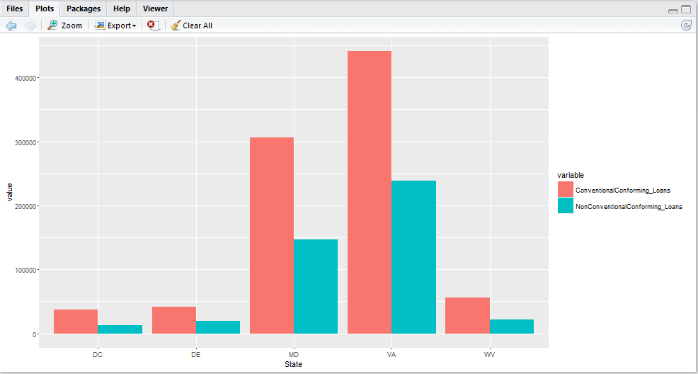
Conventional vs. Non-conventional loans by state
Further analyzing loan applications grouped by state, we see that for all states, number of non-conventional loans are half of the number of conventional loans

Slide 4
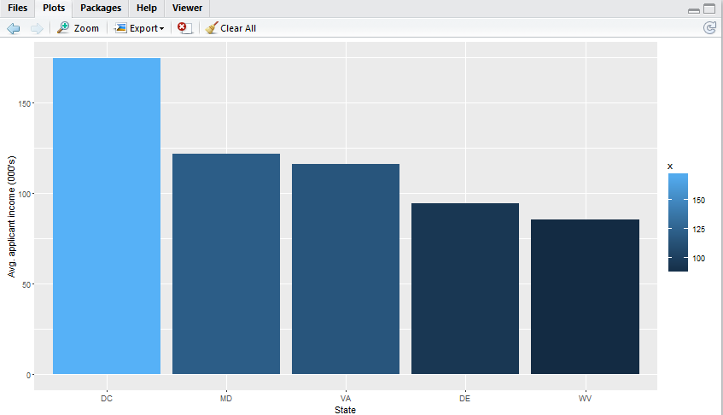
Maryland and Virginia have high average income of loan applicants
Maryland & Virginia have high average income of loan applicants of 121.4 thousand & 115.7 thousand respectively
District of Columbia has the highest average income but percentage of share of loan applications is lowest at 4%
Maryland & Virginia are the two states with high average income and majority percentage share of loan applicants

Slide 5
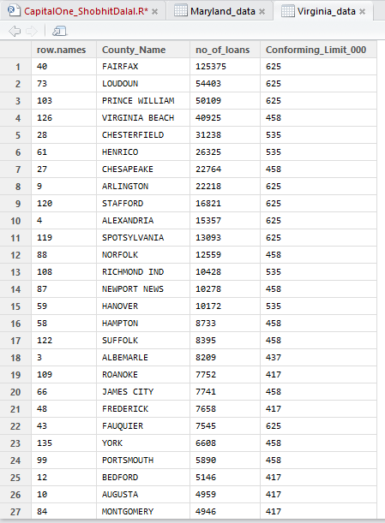
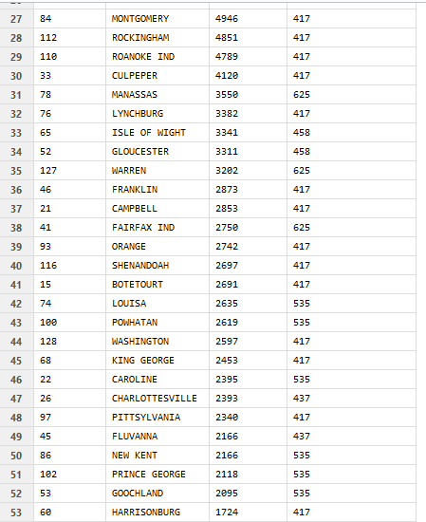
Number of loan applications are higher for counties with higher conforming loan limit
Counties of Virginia

Slide 6
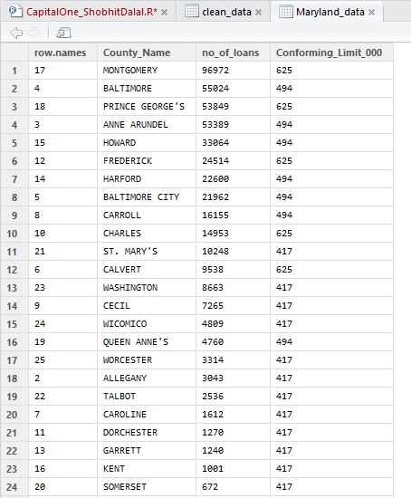
Number of loan applications are higher for counties with higher conforming loan limit
For both states Virginia and Maryland, number of loan applications are directly proportional to the conforming loan limit of that county
Counties of Maryland

Slide 7
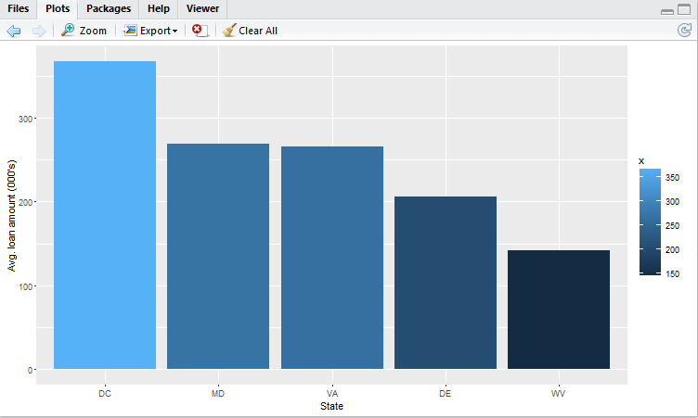
District of Columbia has the highest average loan amount followed by Maryland and Virginia
Maryland & Virginia have high average loan amount of 269.42 thousand & 265.31 thousand respectively
District of Columbia has the highest average loan amount 368.16 thousand

Slide 8
Insights & Recommendations
Maryland and Virginia together consists of 85% of the total loan applications among five states
These two states have 2nd and 3rd highest average applicant income respectively among the five states
Due to large number of loan applications and high income of applicants, Maryland and Virginia looks promising regions for home loans market
Change Financial should initially consider entering home loans market in these states
As number of applications are more in counties with higher single unit conforming loan limit, they should first target counties with higher conforming limit
Change Financial should further analyze the data of District of Columbia as it has the lowest percentage share of loan applications among the five states even though it has the highest average loan amount and highest average income of an applicant
As the number of applications start increasing for Change Financial, they should look to expand further throughout the state as well as other states

Slide 9
Thank You

